Slide 1
Open the black box
Chris Kuo, Ph.D.| Columbia University

Slide 2
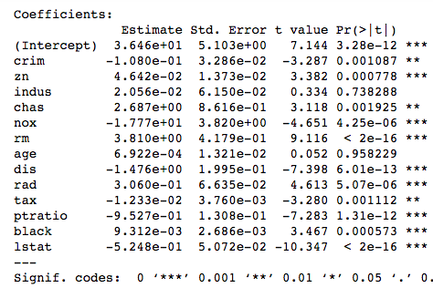
In a linear regression
The variable significance: X is statistically significant at 95% level.
The sign of the coefficient: tells your audience “there is a positive/negative relationship between X and Y.
R2=74%
What do you do with Machine Learning results?

Slide 3
(1) Variable importance
This plot provides a list of the most significant variables in descending order by a mean decrease in Gini.
The top variables contribute more to the model than the bottom ones.
All machine learning techniques
Relative influence (change in Gini)

Slide 4
(2) Partial dependence plot
There is a negative relationship between X and Y.
A partial dependence plot can show the direction between X and Y.
Given multiple predictors, the idea to understand the influence of a single predictor is to “average out” the influence of other predictors.
Friedman( 2001): “Partial dependence functions can be used to interpret the results of any “black box” learning method.”

Slide 5

(2) Partial dependence plot
This is a plot of $f(x_{s})$ vs. $x_{s}$, where $f(x_{s})$ is defined as the response to $x_{s}$ with the other predictors averaged out:
$f\left(x_{s}\right)= \frac{1}{N}\sum_{i=1}^{N}{f(}x_{s},x_{i,−s})$
Friedman: “It is important to note that partial dependence functions represent the effect of $x_{s}$ on $f(x)$ after accounting for the (average) effects of the other variables on $f(x)$. They are not the effect of $x_{s}$ on $f(x)$ ignoring the effects of other variables.

Slide 6
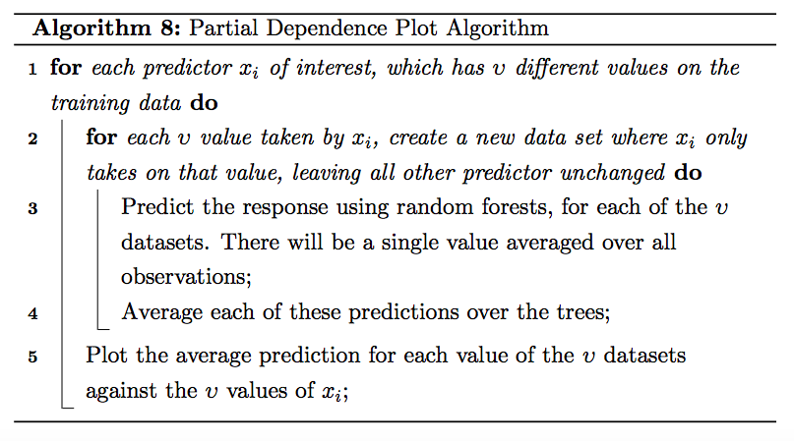
(2) Partial dependence plot

